Slide 1
Warm-Up
What were the 4 influences on American law?

Slide 2
Steps in Court Cases
Unit 7, Part 3

Slide 3
Learning Target
I can explain difference between a criminal case and a civil case
Essential Question
What are the differences between a civil and a criminal case?

Slide 4
Steps to a civil case
Plaintiffs attorney files a complaint
Court sends a summons to defendant
Defendant’s attorney files a written answer
Attorneys for both sides exchange plea documents
Attorneys argue case in court
Court gives verdict

Slide 5
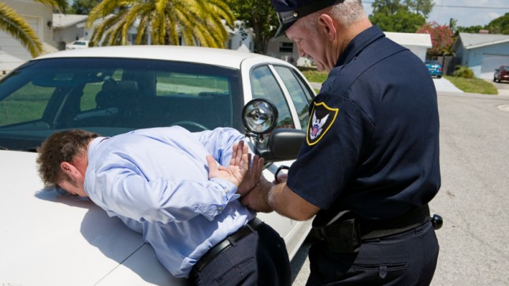
Steps to a Criminal Case
Arrest

Slide 6
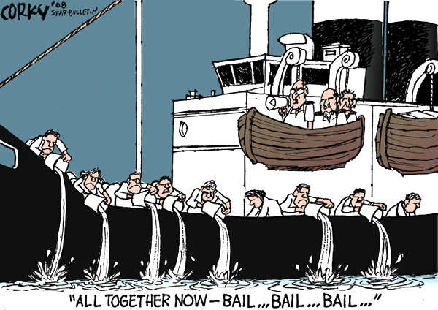
Preliminary Hearing
Suspect appears before judge and bail is set

Slide 7
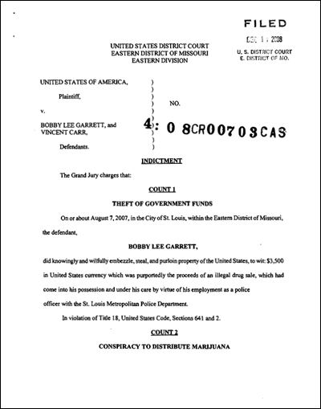
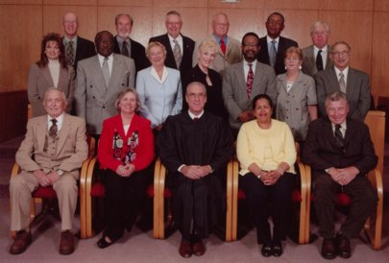
Indictment
Grand Jury (or judge) hears evidence and formally charges

Slide 8
Arraignment
Defendant pleads not guilty and trial date is set
Defendant pleads guilty and accepts plea bargain – conviction of lesser charge for softer sentence

Slide 9
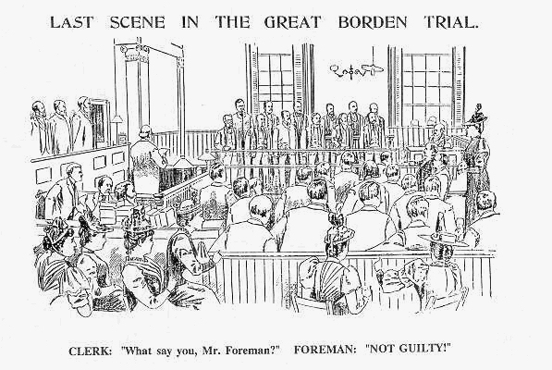
Trial
Prosecution and Defense present case
Jury (or judge) reaches verdict

Slide 10
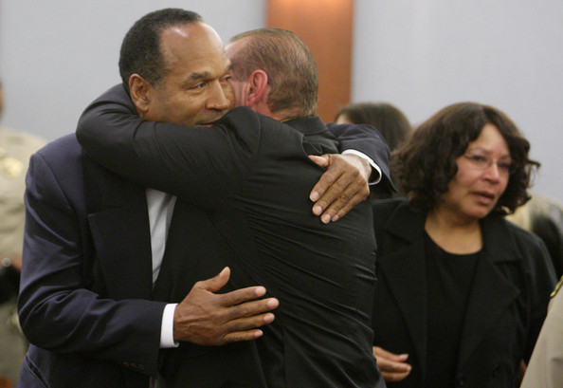
Acquittal
Defendant found not guilty

Slide 11
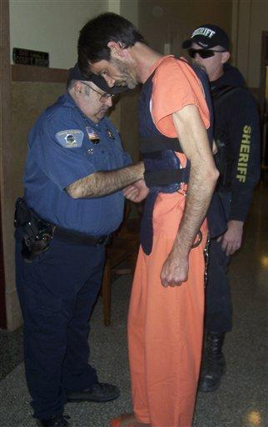
Sentencing
Defendant found guilty and judge sentences (punishes)

Slide 12
Assignment
Watch an episode of Law & Order (or any police show) Include all the steps of either a criminal or a civil case in your writing. DETAILS ARE IMPORTANT.

Slide 13
Review Questions

Slide 14
1. A person who helps resolve disputes by leading the discussion between the two sides and keeping communications open is referred to as
A. an arbitrator
B. an attorney
C. a mediator
D. a plaintiff
C. a Mediator

Slide 15
2. After all the evidence has been presented and the arguments made, the judge or jury will consider the case and then
A. Decide on a verdict
B. Issue an injunction
C. Appeal the case
D. File a complaint
A. Decide on a Verdict

Slide 16
3. What type of suit is filed when a person has been injured or killed?
A. Equity suit
B. Negligence suit
C. Property dispute
D. Breach of contract
B. Negligence Suit

Slide 17
4. The complaint and the answer together referred to as
A. Discovery
B. Pleadings
C. A summons
D. An injunction
B. Pleadings

Slide 18
5. What term refers to a document telling the defendant of the suit against him and ordering him to appear in court on a given fate and time?
A. Injunction
B. Complaint
C. Summons
D. Charge
C. Summons

Slide 19
6. Which of the following is a court order that commands a person or group to stop a certain action
A. Complaint
B. Injunction
C. Summons
D. Plaintiff
B. Injunction

Slide 20
7. A ___ is a formal statement naming the plaintiff and the defendant and describing the nature of the lawsuit.
A. Summons
B. Pleadings
C. Complaint
D. Discovery
C. Complaint

Slide 21
8. Which of the following is a process by which each side can check facts and gather evidence before going to trial?
A. Summons
B. Pleadings
C. Complaint
D. Discovery
D. Discovery

Slide 22
9. ___ are people who act somewhat like a judges by reviewing cases and resolving the disputes
A. Mediators
B. Arbitrators
C. Juries
D. Lawyers
B. Arbitrators

Slide 23
10. The ____ is the party bringing the lawsuit
A. Lawyer
B. Defendant
C. Judge
D. Plaintiff
D. Plaintiff

Slide 24
11. A ___ is a document that tells a person or group of a lawsuit against them and orders them to appear in court on a given date and time
A. Injunction
B. Subpoena
C. Summons
D. Complaint
C. Summons

Slide 25
12. What is the term for the party being sued?
A. Defendant
B. Victim
C. Plaintiff
D. Accuser
A. Defendant

Slide 26
13. What is the term for the complaint and the answer taken together?
A. injunction
B. settlement
C. pleadings
D. arbitration
C. Pleadings

Slide 27
14. The defendant is formally presented with the charges and asked to enter a plea at the
A. Booking
B. Indictment
C. Hearing
D. Arraignment
D. Arraignment

Slide 28
15. Which of the following is NOT a right that police officers must inform citizens of when they are arrested?
A. Right to a trial by jury
B. Right to have an attorney
C. Right to remain silent
D. Right to stop answering questions
A. Right to a Trial by Jury

Slide 29
16. What happens to a defendant when the jury votes for an acquittal?
A. The verdict is appealed
B. The defendant is sentenced
C. The defendant is released
D. The judge rules a mistrial
C. The Defendant is Released

Slide 30
17. Judges must impose whatever sentence the law directs in states that have established
A. Mandatory Sentencing
B. Parole Boards
C. Criminal Penalties
D. Indeterminate Sentencing
A. Mandatory Sentencing

Slide 31
18. Which of the following is considered a victimless crime?
A. Assault
B. Vandalism
C. Fraud
D. Gambling
D. Gambling

Slide 32
19. Crimes and the punishments for them are spelled out in each state’s
A. Arraignment
B. Pleading
C. Penal Code
D. Injunction
C. Penal Code

Slide 33
20. ____ is given under an oath to tell “the truth, the whole truth, and nothing but the truth.”
A. Testimony
B. Acquittal
C. Cross-Examination
D. Arraignment
A. Testimony

Slide 34
21. ____ means that the defendant does not admit guilt but will not fight the prosecution’s case
A. Plea Bargain
B. No Contest
C. Hung Jury
D. Acquittal
B. No Contest

Slide 35
22. When the jury cannot reach a verdict, the judge declares
A. A Plea Bargain
B. An Acquittal
C. A hung Jury
D. A Indictment
C. A Hung Jury

Slide 36
23. A ____ is an act that breaks a federal or state criminal law and causes harm to people or society in general.
A. Delinquent
B. Misdemeanor
C. Felony
D. Crime
D. Crime

Slide 37
24. The ____ is when a defendant is presented with the charges and asked to enter a plea.
A. Arraignment
B. Trial
C. Indictment
D. Hearing
A. Arraignment

Slide 38
25. After a witness testifies for one side, the other side is allowed to ____ him or her.
A. Indict
B. Cross-examine
C. Arraign
D. Contest
B. Cross-Examine

Slide 39
26. After a vote of ____, the defendant is immediately released.
A. a hung jury
B. an arraignment
C. an indictment
D. an acquittal
D. An Acquittal

Slide 40
Matching
27. a meeting called by a judge between both parties in a civil case to help clarify differences between the two sides
28. a court order commanding a person or group to stop a certain action
29. the party bringing a lawsuit
30. agreed amount of money the defendant will pay to the plaintiff
31. the party being sued
a. plaintiff
b. defendant
c. settlement
d. pretrial conference
e. injunction
27. D
28. E
29. A
30. C
31. B

Slide 41
Matching
32. answers witnesses give while under oath
33. formally charged with a crime
34. a state’s written criminal laws
35. an agreement in which an accused person agrees to plead guilty, but to a lesser charge
36. state and federal courts, judges, lawyers, police, and prisons that have the responsibility for enforcing criminal law
a. indicted
b. testimony
c. plea bargain
d. criminal justice system
e. penal code
32. B
33. A
34. E
35. C
36. D

